Slide 1
CHAPTER 4
Internet of Things (IoT)

Slide 2
Contents
What is IoT
The History of IoT
Pros and cons of IoT
How IoT works
Architecture of IoT
IoT tools and platforms
Some of the application areas of IoT

Slide 3
What is IoT?
Different definitions have used by several groups for promoting the particular concept in the whole world.
According to the Internet Architecture Board (IAB),
  IoT is the networking of smart objects, meaning a huge number of devices intelligently communicate in the presence of internet protocol that cannot be directly operated by human beings but exist as components in buildings, vehicles or the environment.
According to the Internet Engineering Task Force (IETF);
  IoT is the networking of smart objects in which these objects have some constraints like limited bandwidth, power, and processing for achieving interoperability.

Slide 4
… Cont’d
According to the IEEE Communications category magazine’s;
  IoT is a framework of all things that have a representation in the presence of the internet in such a way that new applications and services enable the interaction in the physical and virtual world in the form of Machine-to-Machine (M2M) communication in the cloud.
According to Oxford dictionary;
  IoT is the interaction of everyday object’s of computing devices through the Internet that enables the sending and receiving of useful data.
According to the 2020 conceptual framework;
  It is expressed through a simple formula:
  IoT= Services+ Data+ Networks + Sensors

Slide 5
… Cont’d
Generally, IoT is the network of physical objects or "things" embedded with software's, sensors, and network connectivity which enables these objects to collect and exchange data.
Simply it consists of any device with an on/off switch connected to the Internet. This IoT Can be applied in several areas;
  Connected industry
  Smart-city
  Smart-home
  Smart-energy
  Connected car
  Smart agriculture
  Connected building and campus, health care, logistics, among other domains

Slide 6
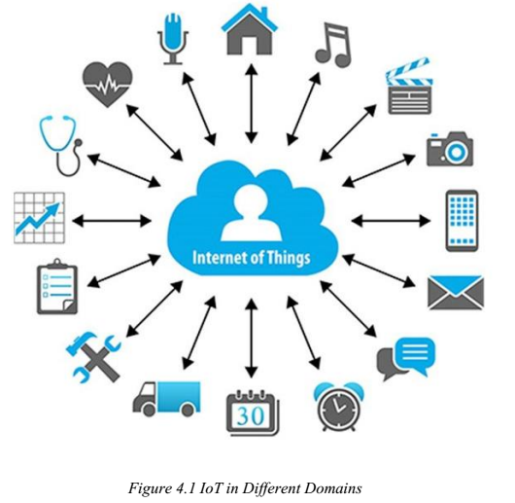
… Cont’d

Slide 7
History of IoT
The Internet of Things has not been around for a long time, However, there have been visions of machines communicating with each other since the early 1800s.
The Internet of Things, as a concept, wasn’t officially named until 1999.
One of the first examples of an Internet of Things is from the early 1980s and was a Coca Cola machine, located at the Carnegie Melon University.
Local programmers would connect by the Internet to the refrigerated appliance, and check to see if there was a drink available and if it was cold, before making the trip.
By the year 2013, the Internet of Things had evolved into a system using multiple technologies, ranging from the Internet to wireless communication and from micro-electromechanical systems (MEMS) to embedded systems.

Slide 8
… Cont’d
Kevin Ashton, the Executive Director of Auto-ID Labs at MIT, was the first person to describe the Internet of Things, during his 1999 speech.
He stated that Radio Frequency Identification (RFID) was a prerequisite for the Internet of Things.
He concluded if all devices were “tagged,” computers could manage, track, and inventory them.
Tagging of things has been achieved through technologies such as digital watermarking, barcodes, and QR codes.
Inventory control is one of the more obvious advantages of the Internet of Things.

Slide 9
IoT Advantages
Improved Customer Engagement: helps business interact with customers more effectively.
Technology Optimization: device can be better utilized and maintained by IoT integration.
Reduced Waste: monitoring usage and automate process
Enhance data collection: continuous and accurate data collection from connected devices

Slide 10
IoT Disadvantages
As the number of connected devices increases and more information is shared between devices, the security problem also increases.
If there’s a bug in the system, it’s likely that every connected device will become corrupted.
Since there’s no international standard of compatibility for IoT, it’s difficult for devices of different manufacturers to communicate with each other.
Enterprises may eventually have to deal with massive numbers maybe even millions of IoT devices and collecting and managing the data from all those devices will be challenging.

Slide 11
Challenges of IoT
Security: IoT creates an ecosystem of constantly connected devices over network which exposed users to various attacks.
Privacy: IoT provides substantial personal data in extreme detail without the user's active participation.
Complexity: Some IoT systems are complicated in terms of design, deployment and maintenance on given technologies.
Flexibility: Many are concerned about the flexibility of an IoT system to integrate easily with another.
  several conflicting or locking systems
Compliance: IoT complexity makes the issue of compliance seem incredibly challenging when many consider standard software compliance.

Slide 12
How does it work?
IoT ecosystem consists of web-enabled smart devices that use embedded processors, sensors and hardware to collect, send and act on data they acquire.
IoT devices share the sensor data they collect by connecting to an IoT gateway or another edge device where data is either sent to the cloud to be analyzed or analyzed locally.
The devices do most of the work without human intervention, although people can interact with the devices.

Slide 13
Architecture of IoT
IoT devices can be explained as a network of things that consists of hardware, software, network connectivity, and sensors.
Hence, the architecture of IoT devices comprise four major components:
  Sensing
  Network
  Data processing and
  Application layers

Slide 14
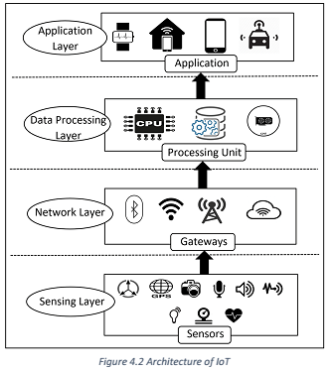
… Cont’d

Slide 15
1. Sensing Layer
The main purpose is to identify any phenomena in the devices’ peripheral and obtain data from the real world.
It consists of several sensors; as using multiple sensors for applications is one of the primary features of IoT devices.
Sensors in IoT devices are integrated through sensor hubs.
  it is a connection point for multiple sensors that accumulate and forward sensor data to the processing unit of a device.
Actuators can also intervene to change the physical conditions that generate the data.
  It can shut off a power supply, adjust an airflow valve, or move a robotic gripper in an assembly process.

Slide 16
  Three categories of sensor devices in IoT
Motion Sensors: to measure the change in motion as well as the orientation of the devices.
  There are two types of motions: linear and angular motions.
  Linear motion: refers to the linear displacement of an IoT device.
  Angular motion: refers to the rotational displacement of the devices.
Environmental Sensors: embedded in IoT devices to sense the change in environmental parameters.
  Include sensors such as Light sensors, Pressure sensors, etc.
  Used in many applications to improve user experience (e.g., home automation systems, smart locks, smart lights, etc.)

Slide 17
… Cont’d
Position sensors: It’s about physical positioning and location of the devices
The most common position sensors used in IoT are magnetic sensors and Global Positioning System (GPS) sensors.
  Magnetic sensors; used as digital compass and help to fix the orientation of the device display.
  GPS is used for navigation purposes in IoT devices.

Slide 18
2. Network Layer
Acts as a communication channel to transfer data collected in the sensing layer.
In IoT devices, the network layer is implemented by using diverse communication technologies (e.g., Wi-Fi, Bluetooth, Zigbee, ZWave, LoRa, cellular network, etc.) to allow data flow between other devices within the same network.

Slide 19
3. Data Processing Layer
Consists of the main data processing unit of IoT devices.
It takes data collected in the sensing layer and analyze it to make a decision based on the result.
In some IoT devices (e.g., smart watch, smart home hub, etc.), the data processing layer also saves the result of the previous analysis to improve the user experience.
This layer may share the result of data processing with other connected devices via the network layer.

Slide 20
4. Application Layer
It implements and presents the results of the data processing layer to accomplish disparate applications of IoT devices.
It is a user-centric layer that executes various tasks for the users.
There exist diverse IoT applications, which include smart transportation, smart home, personal care, healthcare, etc.

Slide 21
Devices and Networks
Connected devices are part of a scenario in which every device talks to each other in an environment to automate home and industrial tasks.
IoT devices are meant to work in concert for people at home, in industry or in the enterprise.
As such, the devices can be categorized into three main groups:
  Consumer
  Enterprise and
  Industrial.
Consumer connected devices include smart TVs, smart speakers, toys, wearables, and smart appliances.

Slide 22
… Cont’d
Smart meters, commercial security systems and smart city technologies such as those used to monitor traffic and weather conditions are examples of industrial and enterprise IoT devices.
In the enterprise, smart sensors located in a conference room can help an employee locate and schedule an available room for a meeting, ensuring the proper room type, size and features are available.

Slide 23
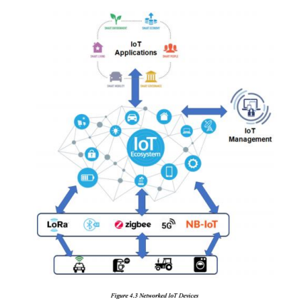
… Cont’d

Slide 24
IoT Tools and Platforms
There are many vendors in the industrial IoT platform marketplace, offering similar capabilities and methods of deployment.
These IoT Platform Solutions are based on the Internet of Things and cloud technology.
They can be used in areas of smart home, city, enterprise, home automation, healthcare or automotive.

Slide 25
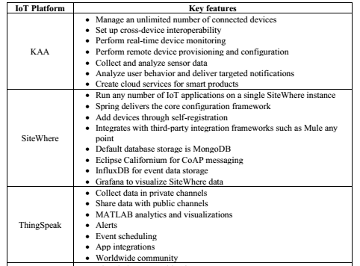
… Cont’d

Slide 26
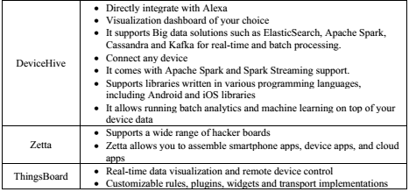

… Cont’d

Slide 27
Applications of IoT
The versatile nature of IoT makes it an attractive option for so many businesses, organizations, and government offices.
Various application of IoT are;
  Agriculture: For indoor and outdoor planting IoT used to monitor microclimate, sense soil moisture and nutrients, better control of smart irrigation and fertilizer systems.
  Consumer Use: For private IoT devices in the form of wearables and smart homes make life easier. Wearables cover accessories such as Fitbit, smartphones, Apple watches, health monitors.
  Healthcare: Wearable IoT devices let hospitals to monitor their patients’ health at home. In hospitals, smart beds keep the staff informed as to the availability, thereby cutting wait time for free space.

Slide 28
… Cont’d
Insurance: Insurance companies can offer their policy holders discounts for IoT wearables such as Fitbit.
Manufacturing: RFID and GPS technology can help a manufacturer to track a product from its start on the factory floor to its placement in the destination store, the whole supply chain from start to finish.
Retail - Online and in-store shopping sales figures can control warehouse automation and robotics, information gleaned from IoT sensors.
Transportation: The GPS is being utilized to help transportation companies to plot faster and more efficient routes for trucks hauling freight, thereby speeding up delivery times. It can be used to determine traffic patterns, parking space demand, and road construction and maintenance.
Utilities: IoT sensors can be employed to monitor environmental conditions such as humidity, temperature, and lighting.
The information provided by IoT sensors can aid in the creation of algorithms that regulate energy usage and make the appropriate adjustments.

Slide 29
IoT Based Smart Home
Smart Home initiative allows subscribers to remotely manage and monitor different home devices from anywhere via smartphones or over the web with no physical distance limitations.
These “smart” devices have the potential to share information with each other over internet connection.
  Remote Control Appliances
  Smart home Appliances
  Weather
  Safety monitoring
  Energy and water use
  Intrusion detection system

Slide 30
IoT Based Smart City
In cities, the development of smart grids, data analytics, and autonomous vehicles will provide an intelligent platform to deliver innovations in energy management, traffic management, and security, sharing the benefits of this technology throughout society.
  Structural hall
  Lightening
  Safety
  Transportation
  Waste management
  Green house
  Animal farm/tracking
  Field monitoring

Slide 31

Any Question?

